Slide 1


Recitation 2
Introduction to Computer Science
Reichman University
Notes:
‹#›

Slide 2

In Memoriam
This recitation is dedicated to the memory of Sargent Major (res’) Joseph (Joe) Gitarts. Joe fell on December 25th 2023 during a battle in South Gaza. Joe was scheduled to start his second year here at RUNi this semester. May he rest in peace.

Slide 3
From Joe's Letter to his Parents
Dear mom and dad, I love you very much.
Everything is as it should be. I chose this myself. I’ve lived good and interesting life, yet I have never been afraid of death. I could have chosen not to come here and hide, but that would have gone against everything I believe in and value, and who I consider myself to be.
So, I had no choice, and I would do the same thing if could choose again. I made this choice myself and went with it to the end. I fell with honor for the sake of my people. I have no regrets. I love you very much and am proud that you are my parents. I had very interesting, rich, happy and unique life.
My death only emphasize that.
You are surely in great pain. But you will overcome it. I really wanted this. It’s the most important thing I want. Both of you have many close people who will support you. Please find something positive in all of this. Be with the grandchildren. Support Israel. I’m okay.

Slide 4
Today
Flow Control
Conditions - if, else, else if, switch
Loops - while, for
Strings methods
Variable Scope
Notes:
‹#›

Slide 5
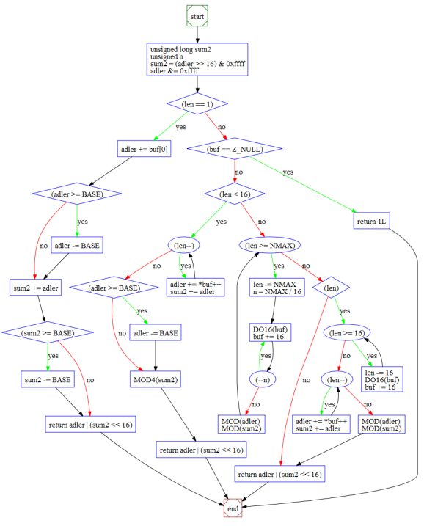
Control Flow - Conditions
Introduction to Computer Science
Reichman University
Recitation 2
Notes:
‹#›

Slide 6
Question 1 – Conditioning
Many board games have an element of 2 dice roll,
Reminder: A fair 6-sided dice have the numbers between 1 and 6 (included) and the odds of getting each one is the same.
A “double” (in dice roll terms, not the data type) is considered as the case when 2 dice are rolled together and number displayed matches between them. IE they have the same value.
Design a Java program that simulates the roll of a 2 six-sided dice.
When executed, the program should generate 2 random numbers between 1 and 6 (inclusive) to represent the outcome of a dice rolls.
Then display the results to the user.
If the user rolled a double, print it to the screen.
Ensure that in each roll, each number between 1 and 6 has an equal chance (as possible) of being rolled (AKA fair 6-sided dice). You may use Math library freely in the solution.
Notes:
‹#›
Warmup

Slide 7
Question 1 – Solution
public class DoubleDiceRoll {
public static void main(String[] args){
int dice1 = (int)((Math.random() * 6) + 1);
int dice2 = (int)((Math.random() * 6) + 1);
if (dice1 == dice2){
System.out.println("You rolled a double " + dice1 + "!!");
} else {
System.out.println("You rolled " + dice1 + " and " + dice2);
}
}
}
Notes:
‹#›
Warmup

Slide 8
Question 2 – Conditioning
In Israel, we usually grade, assignments and test with a scale between 0-100. But in some places, for example, in the US, the grade system uses letter values. ‘A’ if got 90 or higher, ‘B’ if between 80-89, ‘C’ if between 70-79, ‘D’ if between 60-69, otherwise ‘F’.
Design a program which does the following:
Receives a number from the user which represent the numerical grade of the user.
You may assume that the grade in number is within 0-100 range.
Assign a grade letter for the students (‘A’ if got 90 or higher, ‘B’ if between 80-89, ‘C’ if between 70-79, ‘D’ if between 60-69, otherwise ‘F’)
Prints the solution
Notes:
‹#›
Warmup

Slide 9
Question 2 - Solution
public class GradeCalc {
public static void main(String[] args){
int score = Integer.parseInt(args[0]);
char grade = ‘0’;
if (score >= 90){
grade = ‘A’;
} else if (score >= 80){
grade = ‘B’;
} else if (score >= 70){
grade = ‘C’;
} else if (score >= 60){
grade = ‘D’;
} else {
grade = ‘F’;
}
System.out.println(“Grade = “ + grade);
}
}
Notes:
‹#›
דיון: למה התנאי השני הוא לא score <= 89 && score >= 80

Slide 10

Control Flow - Switch
Introduction to Computer Science
Reichman University
Recitation 2
case Z:
case Y:
case X:
switch
default
Notes:
‹#›

Slide 11
The Switch Statement
Syntax
The expression value is compared to each case value; if there’s a match, the corresponding statement is executed
If none of the values matches, the default statement is executed
default is optional and equivalent to else
The type of the variable and the values must be integral (byte, short, char, int), or String
The flow of control continues through all the cases, even after a match;
To tank out, use break.
switch variable {
case value1:
code segment 1
case value2:
code segment 2
...
default:
default code segment
}

Slide 12
Question 3 – Switch Case
When we use the Gregorian calendar, each month is assigned a number (1 -> “January”, etc.)
Design a program which translates from number to Month name.
Receives a number from the user
If it is a valid month number, (IE in the the range of 1-12), it returns the name of the respective month (1 -> “January”, etc.), otherwise, put an “Invalid month”.
Then prints the solution
Notes:
‹#›

Slide 13
Question 3 - Solution
int month = Integer.parseInt(args[0]);
String monthString;
switch (month) {
case 1: monthString = "January";
break;
case 2: monthString = "February";
break;
case 3: monthString = "March";
break;
case 4: monthString = "April";
break;
case 5: monthString = "May";
break;
case 6: monthString = "June";
break;
case 7: monthString = "July";
break;
case 8: monthString = "August";
break;
case 9: monthString = "September";
break;
case 10: monthString = "October";
break;
case 11: monthString = "November";
break;
case 12: monthString = "December";
break;
default: monthString = "Invalid month";
break;
}
System.out.println(monthString);
Notes:
אם היינו מגדירים את המשתנה בפנים- לא היינו יכולים להדפיס אותו בסוף
בגלל scope

Slide 14
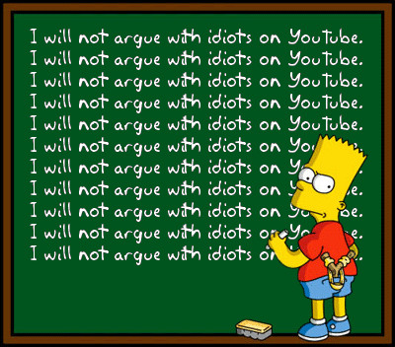
Control Flow - Loops
Introduction to Computer Science
Reichman University
Recitation 2
Notes:
‹#›

Slide 15
Question 4 – Prime Numbers
A prime number is a positive integer n > 1, such that its only divisors are 1 and n itself.
Despite what seems like a pure mathematical concept, prime numbers play important roles in many areas of computer science. Notably in Cryptography.
We will implement a basic program to decide if a given number is prime.
Design a program which does the following:
Receives from the user an integer “num”.
Checks to see if “num” has any divisors other than 1 and itself.
Let's the user know if “num” is prime or not.
% java prime 10
10 isn’t prime.
% java prime 7
7 is prime.
% java prime 32452867
32452867 is prime.
Notes:
‹#›

Slide 16
Question 4 - Solution
public static void main(String[] args){
int num = Integer.parseInt(args[0]);
boolean isPrime = num > 1;
for (int i = 2; i < num && isPrime; i++){
isPrime = (num % i != 0);
}
if (isPrime){
System.out.println(num + “ is prime.”);
} else {
System.out.println(num + “ is not prime.”);
}
}
Notes:
‹#›
אם יש זמן- כמה פעמים הלולאה רצה, בצעות ייעול?

Slide 17
Loops - why and when to use each?
While is more commonly used when we don't know the exact number of iterations. while is freer to use but there is more likelihood to have an infinite loop.
For is more commonly used when we do know the exact number of iterations. for is has more restrictions to use but the structure help to avoid infinite loops.
Notes:
‹#›
כלל אצבע- כשידוע מראש כמה פעמים הלולאה צריכה לרוץ ללא תלות בדברים שקורים בפנים- נשתמש בפור
בגדול כל דבר שאפשר לעשות עם אחת אפשר לעשות עם השניה- אבל זה יותר נכון תחבירית..

Slide 18
Question 5 - Loops
We already build a code which emulates a single dice roll and a couple of rolls.
Let's build a program which rolls 10 dice rolls then return the sum of those rolls
Design a program
That simulates the roll of a six-sided dice 10 times. After each roll, and add the current value, and after all 10 rolls, sum and display the sum of the outcomes.
Ensure that each number between 1 and 6 has an equal chance of being rolled during each individual roll.
Notes:
דיון האם זה יהיה for או while

Slide 19
Question 5 - Solution
public class RollTenRolls {
public static void main(String[] args) {
int sum = 0;
for (int i = 0; i < 10; i++) {
int dice = (int) (Math.random() * 6) + 1;
sum += dice;
}
System.out.println("The sum of 10 dice rolls is " + sum);
}
}

Slide 20
Question 5, Expansion 1 - Loops
Let's upgrade the program by adding a single command line argument
You may assume that argument is going to be true or false.
Design a program
That receives a single ’boolean’ command line argument from user.
Then simulates the roll of a six-sided dice 10 times. After each roll, and add the current value, and after all 10 rolls, sum and display the sum of the outcomes.
Ensure that each number between 1 and 6 has an equal chance of being rolled during each individual roll.
If the given command line argument is “true” print the outcome of every roll.

Slide 21
Question 5, Expansion 1 - Solution
public class RollTenRolls {
public static void main(String[] args) {
boolean shouldPrint = Boolean.parseBoolean(args[0]);
int sum = 0;
for (int i = 0; i < 10; i++) {
int dice = (int) (Math.random() * 6) + 1;
sum += dice;
if (shouldPrint) {
System.out.println("Roll " + i + ": " + dice);
}
}
System.out.println("The sum of 10 dice rolls is " + sum);
}
}
Notes:
explain the if

Slide 22
Question 5, Expansion 2 - Loops
Lets upgrade the program by adding another command line argument
The first one is going to be the same, the second is an int, which is going to be positive.
The second argument is going to represent the number of rolls.
Design a program
That receives a couple command line arguments from user. The first ‘shouldPrint’ is a boolean, the second ‘nTimes’ (AKA N) is an int
Then simulates the roll of a six-sided dice N times. After each roll, and add the current value, and after all N rolls, sum and display the sum of the outcomes.
Ensure that each number between 1 and 6 has an equal chance of being rolled during each individual roll.
if ‘shouldPrint’ is true print the outcome of every roll
Notes:
דיון האם זה יהיה for או while

Slide 23
Question 5, Expansion 2 - Solution
public class RollTenRolls {
public static void main(String[] args) {
boolean shouldPrint = Boolean.parseBoolean(args[0]);
int nTimes = Integer.parseInt(args[1]);
int sum = 0;
for (int i = 0; i < nTimes; i++) {
int dice = (int) (Math.random() * 6) + 1;
sum += dice;
if (shouldPrint) {
System.out.println("Roll " + i + ": " + dice);
}
}
System.out.println("The sum of 10 dice rolls is " + sum);
}
}
Notes:
explain the if

Slide 24
Question 6 - Loops
One of the classic board games is called Ropes and Ladders
Design a program which emulates the game for a single player
The player start at position 1.
The player rolls a 6-sided dice. and move according to the number mentioned on the dice.
The objective of the game is to reach the 100th square.
If a player lands on a square that is the base of a ladder, they must climb the ladder, skipping a number of squares ahead.
Ladders : 4->14, 9->31, 20->38, 24-> 84, 40->59
If a player lands on a square that has the head of a snake, they must slide down the snake, going back a number of squares.
Ropes : 17->7, 87-> 24, 93-> 53, 95-> 75, 99->18
If a player exceed the 100th square it is equivalent to getting to the 100th square.
In the end, print the number of dice rolls it took to achieve it.

Slide 25
Question 6 - Solution
public class RopesAndLadders {
public static void main(String[] args) {
int dice = 0;
int rolls = 0;
int position = 0;
while (position < 100) {
dice = (int) (Math.random() * 6) + 1;
rolls++;
position += dice;
if (position == 4) {
position = 14;
} else if (position == 9) {
position = 31;
} else if (position == 17) {
position = 7;
} else if (position == 20) {
position = 38;
} else if (position == 28) {
position = 84;
} else if (position == 40) {
position = 59;
} else if (position == 87) {
position = 24;
} else if (position == 93) {
position = 53;
} else if (position == 95) {
position = 75;
} else if (position == 99) {
position = 18;
} else {
position = position;
}
}
System.out.println("You won after " + rolls + " rolls!");
}
}

Slide 26
Question 7 – Fair Dice
A fair dice gives values from 1 to 6, such that each value has the same probability.
A natural question to ask is how many times (on average) must we throw the dice before a certain value, let’s say 6, appears.
Surprisingly, the mathematical calculations involved are not that simple. This is were computer simulations can come in and help us approximate the solution.
Design a program which does the following:
Receives from the user an integer – the number of simulations.
Runs a simulation of throwing a dice until 6 appears, according to the given number.
Prints the average number of throws, over all simulations, until 6 appeared.
Notes:
‹#›

Slide 27
Question 7 - Fair Dice - Solution
public static void main(String[] args){
int times = Integer.parseInt(args[0]);
int sum = 0; // variable to store answer,
// initialized to 0 since 0 is neutral to
// addition (number + 0 == number)
for (int i = 0; i < times; i++){
int dice = 0;
int count = 0;
while (dice != 6){
dice = (int)(Math.random() * 6 + 1);
count++;
}
sum = sum + count;
}
System.out.println((double) sum / times);
}
Notes:
‹#›
יודעים כמה פעמים מריצים- לכן נשתמש בפור
בפנים- כל עוד לא יצא 6 כלומר לא ידוע – לכן נשתמש בוויל
אפשר להגיד שהיינו יכולים להשתמש גם ב דו-וויל

Slide 28
Fair Dice - Results
% java FairDice 10
8.2
% java FairDice 100
5.67
% java FairDice 1000
5.973
% java FairDice 10000
5.9948
% java FairDice 100000
6.00523
% java FairDice 1000000
5.999954
Notes:
‹#›

Slide 29

Shorthand Operations
Introduction to Computer Science
Reichman University
Recitation 2
Notes:
‹#›

Slide 30
Shorthand Ops
Shorthand operators in Java allow you to write more concise code for common operations and assignments.
Advantages:
Improved code readability.
Concise expressions for common operations.
Can make your code more efficient and easier to maintain.
int y = 10;
y--; // Decrement by 1 (Equivalent to y = y - 1)
int x = 5;
x++; // Increment by 1 (Equivalent to x = x + 1)
int b = 7;
b -= 6; // Subtracts 6 from 'b' (Equivalent to b = b - 7)
int a = 5;
a += 3; // Adds 3 to 'a' (Equivalent to a = a + 3)
int price = 20;
price /= 2; // Divides 'price' by 2 (Equivalent to price = price / 2)
int total = 8;
total *= 5; // Multiplies 'total' by 5 (Equivalent to total = total * 5)
Notes:
‹#›

Slide 31
Shorthand Ops - i++ Vs ++i ?
There are some languages which uses ++i rather than i++.
What is the difference between them?
When you see ++i at line n, it means that there is an “imaginary” line between lines n-1 and n, which increases the value of i by 1.
int i = 4;
System.out.println(++i); // 5
System.out.println(i); // 5
When you see i++ at line n, it means that there is an “imaginary” line between lines n and n+1, which increases the value of i by 1.
int i = 4;
System.out.println(i++); // 4
System.out.println(i); // 5
Tip: always use i++ over ++i.
Notes:
‹#›

Slide 32
Question 8 - i++ Vs ++i
The following for segments of code are very similar.
3 of those will have the same output, one will have different output.
Which one is it? Why?
int n = 6;
for (int i = 0; i < n; i++) {
System.out.println(i);
}
int n = 6;
for (int i = 0; i < n; ++i) {
System.out.println(i);
}
int n = 6;
int i = 0;
while (i < n) {
System.out.println(i++);
}
int n = 6;
int i = 0;
while (i < n) {
System.out.println(++i);
}
A
B
C
D
Notes:
האחרון
להסביר מכניקה של שורת for

Slide 33
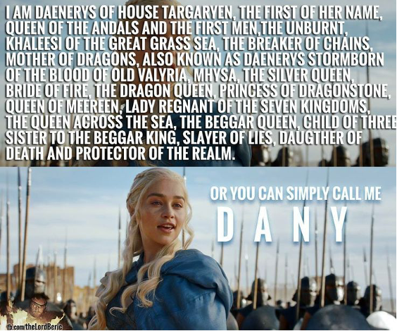
Variable Scope
Introduction to Computer Science
Reichman University
Recitation 2
Notes:
‹#›

Slide 34
Variable Scope
In Java, each block is equal to a scope. Meaning, any segment of code contained within curly brackets is a scope.
Scopes can be contained in other scopes (for example, nested ifs).
A scope determines what variables are visible and accessible to other part of your program.
The scope of a local variable is the rest of the block in which it was declared.
Variables cannot be called or used outside their scope.
The name of a local variable v cannot be used again in the same scope.
Notes:
‹#›
להדגיש שהזיכרון שהוקצע התשחרר

Slide 35
The “Khaleesi Rule” - Metaphor for scoping
Assume that a given room is a scope, “Khaleesi” is the variable, “Khaleesi”’s reaction is the compiler (Not an official name but a way to remember)
If you try to address “Khaleesi” before she was properly introduced (declared) -> you disrespect her therefore “dracarys“ (compiler error).
If you try to introduce her properly twice in the same room -> you are wasting her time therefore “dracarys“.
If you have room inside a room and introduced her properly in the bigger room and afterwards try to introduce her properly again in smaller room -> you are wasting her time therefore “dracarys“.
If you have room inside a room and introduced her properly in the smaller room and try to address her in the bigger room -> you disrespect her therefore “dracarys“.
If you have room inside a room and introduced her properly in the smaller room and afterward try to introduce her properly in the bigger room -> OK.
If you have room inside a room and introduced her properly in the bigger room and afterwards try to address her in smaller room -> OK .
Notes:
‹#›

Slide 36
Example 1 & 2 - Scope
public static void main (String[] args) {
// a’s scope starts here
int a = 10;
while (true) {
int a = 100;
// Compilation error – a already ‘exists’ in this scope
}
}
// a’s scope ends here, upon exiting ‘main’
public static void main (String[] args) {
while (true) {
// a’s scope starts here
int a = 100;
}
// a’s scope ends here
System.out.println(a);
// Compilation error – a doesn’t ‘exist’ in this scope
}

Slide 37
Example 3 & 4 - Scope
public static void main (String[] args) {
// a’s scope starts here
int a = 10;
while (true) {
a = 100;
// that’s fine, just a reassignment
}
}
// a’s scope ends upon exiting ‘main’
public static void main (String[] args) {
while (true) {
// a’s scope starts here
int a = 100;
// note that each iteration uses a new declaration.
}
// a’s scope ends upon exiting the loop
int a = 100;
}

Slide 38
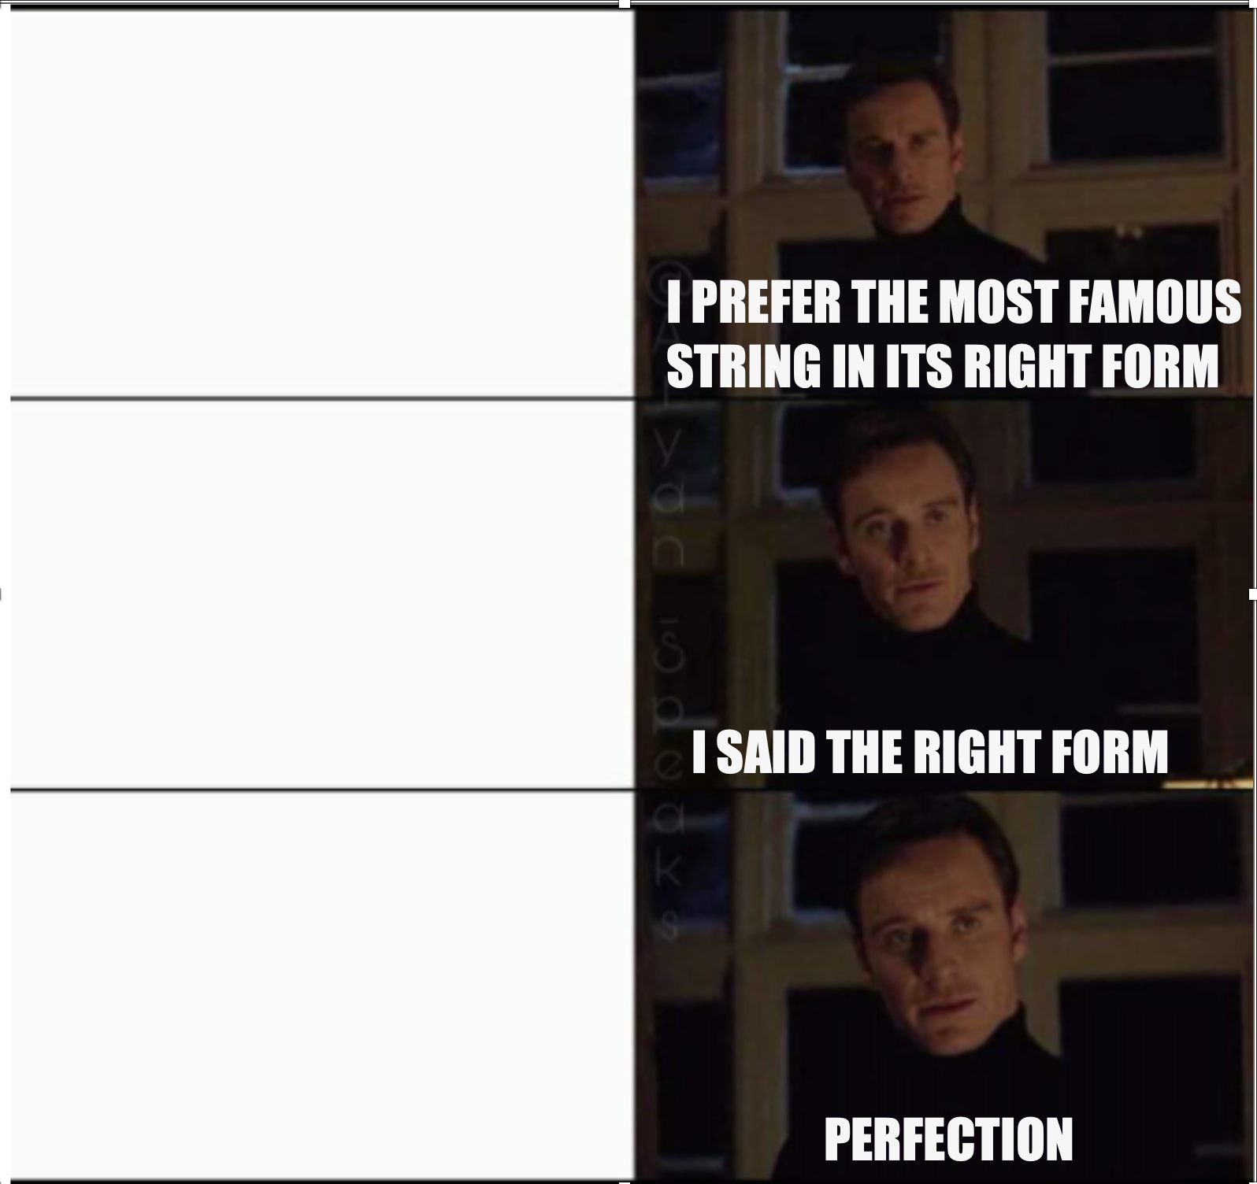
Strings
Introduction to Computer Science
Reichman University
Recitation 2
string str = ‘Hello World’;
string str = “ Hello World “;
String str = “ Hello World “;
Notes:
‹#›
להזכיר במדעי המחשב תמיד מתחילים לספור מאפס
יש פונקציות מובנות של מחרוזות שאפשר להשתמש בהן

Slide 39
Strings - Examples
// 5
// ‘e’
//Runtime Error
//Runtime Error
//-1
//4
//2
String str = “Hello” ;
str.length();
str.charAt(1);
str.charAt(7);
str.charAt(-1);
str.indexOf(‘h’);
str.indexOf(‘o’);
str.indexOf(‘l’);
Notes:
‹#›

Slide 40

Strings - Revisited
One problem with strings not being primitive objects is that things don’t always work like we expect them to.
String a = “a”;
String b = “a”;
System.out.println (a == b);
// true
However, consider the following program to compare input strings:
public class Strings{
public static void main(String[] args){
String a = args[0];
String b = args[1];
System.out.println(a == b);
}
}
% java Strings a a
false
Notes:
‹#›

Slide 41
Question 9: Strings - Revisited
What happened there?
When comparing strings using ‘==‘ java actually checks the where in the memory, both strings are stored, since the locations in the memory of the strings and not the same the answer is false. The value itself wasn’t checked.
Since the compiler could not know before hand that the command line arguments would be identical, they got different addresses.
In general, it’s bad practice to compare strings using ‘==‘. Unless you’re actually interested to compare their addresses. We will use ‘==‘ for primitive types only.
Note : This “phenomenon” is not specifically with strings. Every non-primitive type works that way.
To compensate, let’s write a program which checks if two strings are the same. Why? One of the key aspect of coding is making consistent code.
Notes:
‹#›

Slide 42
Question 9 - Solution
public class EqualStrings {
public static void main(String[] args){
String a = args[0];
String b = args[1];
boolean ans = a.length() == b.length();
for (int i = 0; i < a.length() && ans; i++){
ans = (a.charAt(i) == b.charAt(i));
}
System.out.println(ans);
}
}
Notes:
‹#›
Why a.charAt(i) == b.charAt(i) works?

Slide 43
Question 9, Expansion 1 - Strings
Sometimes it is not enough to figure out which string is bigger in terms of lexicographic order. Assume the strings are only lowercase letters.
Lexicographical order, also known as dictionary order, alphabetic order, or lexicographic sequence, is a generalization of the way words are alphabetically ordered based on the alphabetical order of their component letters. It is the way in which symbols (such as letters, numbers, and other characters) are arranged to be sorted in dictionaries, indices, directories, and databases.
The basic principle is that shorter sequences come before longer ones, and sequences of the same length are compared element by element. For instance, if the symbols are numbers, then 123 comes before 1234, which in turn comes before 124. If the symbols are letters, the order will follow the typical order of the alphabet in a given language (e.g., 'apple' comes before 'banana' in English).
Strings of different lengths: A shorter string is considered smaller if it is a prefix of a longer string, e.g., "abc" is less than "abcd".
Strings of the same length: Comparison is done based on the order of characters, e.g., "abcd" is less than "abce".
This method of ordering is heavily used in computer science, whether in sorting lists of words, ordering items in databases, dirs and file systems, and various algorithms.
Let change our code such that if the strings are equal we will print 0, if the first one comes before the second one we will print -1. if the second one comes before the first print 1.
Notes:
‹#›
דיון למה boolean לא מתאים? (אין מספיק ערכים להצביע על 3 המצבים האפשריים)

Slide 44
Question 9, Expansion 1 - Strings
java CompareStrings abc abc
0
java CompareStrings abc abcd
-1
java CompareStrings abc abd
-1
java CompareStrings abc abac
1
java CompareStrings abc ab
1
Notes:
‹#›

Slide 45
Question 9, Expansion 1 - Solution
public class CompareStrings {
public static void main(String[] args){
String a = args[0];
String b = args[1];
boolean ans = true;
int res = -2;
for (int i = 0; i < a.length() && ans; i++){
ans = (a.charAt(i) == b.charAt(i));
if (!ans) {
res = a.charAt(i) > b.charAt(i) ? -1 : 1;
}
}
if (a.length() != b.length()) {
res = a.length() > b.length() ? -1 : 1;
} else {
res = 0;
}
System.out.println(res);
}
}
Notes:
‹#›

Slide 46
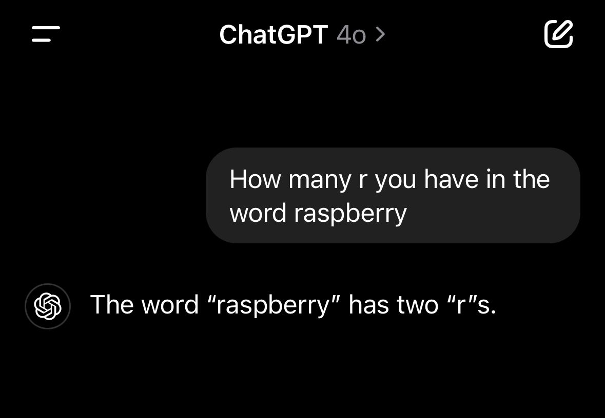
Question 10 – Strings
Let’s look at the following prompt from ChatGPT.
Who can tell me what is wrong here?
The word raspberry has 3 "r”s
raspberry
What happens here? The AI splits the word raspberry to 2 words (”rasp” and “berry”). And returns the more probable answer of the 2 options which in this case is 2.
Let's build a function which will be able to work on all 3 word correctly
https://prompt.16x.engineer/blog/why-chatgpt-cant-count-rs-in-strawberry
The problem was discovered on strawberry, which was fixed. But the problem currently live in raspberry. So you can try it yourself.

Slide 47
Question 10 – Strings
Design a program which does the following:
The program receives a string (will be called str for the question and a char (will be called ch in the question) from the users.
you may assume that the second command line argument is only one char.
Think how can you convert a String to char.
Then the program counts the number of appearances of ch in str
prints it
Examples
% java CharRunCount rasp r
1
% java CharRunCount berry r
2
% java CharRunCount raspberry r
3
% java CharRunCount raspberry R
0
% java CharRunCount "raspberry juice” r
3
% java CharRunCount Hello t
0
Notes:
‹#›

Slide 48
Question 10 - Solution
public class CharRunCount {
public static void main(String[] args){
String word = args[0];
char ch = args[1].charAt(0);
int count = 0;
for (int i = 0; i < word.length(); i++){
if (word.charAt(i) == ch){
count++;
}
}
System.out.print("the char: " + ch + " appears " + count);
System.out.println(" times in the word: " + word);
}
}
Notes:
‹#›

Slide 49
Question 11 – Strings
Strings are immutable which mean they can’t be changed. For example: it is not possible to a char inside the string directly by assigning it a new value:
String str = “hello world”;
str.charAt(3) = ‘8’;
The second statement will cause runtime error.
To compensate, let’s design a program which does the following:
Receives a string from the users.
changes all ‘m’ in the string to ‘P’. print string after change.
Examples:
% java AlterStrings “main”
Pain
% java AlterStrings “Main”
Main
% java CharRunCount “mom”
PoP
Notes:
‹#›

Slide 50
Question 11 - Solution
public class AlterStrings {
public static void main(String[] args){
String original = args[0];
String res = ""; //"" is neutral to concat in Strings
for (int index = 0; index < original.length(); index++){
char chr = original.charAt(index);
res += chr == ‘m’ ? ‘P’ : chr;
}
System.out.println(res);
}
}
Notes:
‹#›

Slide 51
Question 12 – Strings
We talked about the string method str.indexOf(char ch)
let’s design a program which works similarly.
The program receives a 2 strings from the user.
Validate the second string input (suppose to be a char) :
if it is an empty string : assign the value space (‘ ‘).
if it has one char or more : take the first char only.
The program shows the first index that the second validated string appears in the first String. if it does appear otherwise shows the value -1.
Note: In these kind of questions, when you are required to implement a function which exists. You may not use the original function or any other built in functions which has a similar goal (unless specified otherwise), even if you learnt those functions in class.
Therefore, we cannot use the function str.indexOf(char ch); or any other string methods which find a char in string.
Notes:
‹#›

Slide 52
Question 12 - Solution
public class FindCharInString {
public static void main(String[] args){
String source = args[0];
char chr = args[1].length() > 0 ? args[1].charAt(0) : ’ ’;
String temp = “Find the char: “ + chr + ”in the string: ”;
temp += source;
System.out.println(temp);
int result = -1; // if index not found return -1 as error control
boolean flag = false;
for (int index = 0; index < source.length() && !flag; index++){
if (chr == source.charAt(index)){
result = index;
flag = true;
}
}
System.out.println(result);
}
}
Notes:
‹#›

Slide 53
Question 13 – Strings
Sometimes you can combine previously solved questions in order to solve a new question (with slight changes)
We will use two questions that we already solved today with minor changes to get the solution.
Note: A version of the next question appeared in Midterm 2022 (Q5 there for the curious)
Design a program which receives a String and a char from the user
then prints the number of every appearance of that char with the position it appears in the String
Example:
% java AllIndexOf “hello world” l
(1,2),(2,3),(3,9)
% java AllIndexOf “hello worLd” l
(1,2),(2,3)
% java AllIndexOf “hello world” p
“” // empty string
Notes:
‹#›

Slide 54
Question 13 - Solution
public class AllIndexOf {
public static void main(String[] args) {
// Q10 - charRunCount
String word = args[0];
char ch = args[1].charAt(0);
int count = 0;
for (int i = 0; i < word.length(); i++) {
if (word.charAt(i) == ch){
count++;
}
}
System.out.println("the char: " + " appears " + count + " time in the word: " + word);
// Q12 - FindCharInString (with some adjustments)
String temp = "Find all appearnces of the char: " + ch + "in the string: " + word;
System.out.println(temp);
int curCounter = 1;
String res = "";
for (int index = 0; index < word.length() && curCounter <= count; index++){
if (ch == word.charAt(index)){
if (curCounter != 1){
res += ","; // Aesthetics
}
// note curCounter value increased by 1 after the following is excecuted
res += "(" + (curCounter++) + "," + index + ")";
}
}
System.out.println(res);
}
}
Notes:
‹#›

